Slide 1

Hugging Face Transformers vs.
OpenAI GPT-4 API
Presentation by:
FAST JET LEARNERS ROCKETS (FJLR)
Members:
FAIZA ABDULLAH
JONAH JOSEPH
LYAZZAT ZILGARINA
RYAN YAUCH

Slide 2
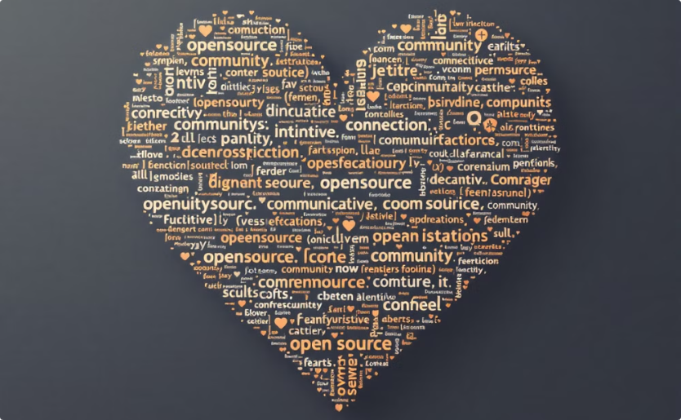

BACKGROUND
Hugging Face Transformers
OpenAI GPT-4 API
Open-source library, democratizes AI by providing easy access to pre-trained models and tools
Closed-source, state-of-the-art generative model, offering superior natural language understanding and generation capabilities

Slide 3
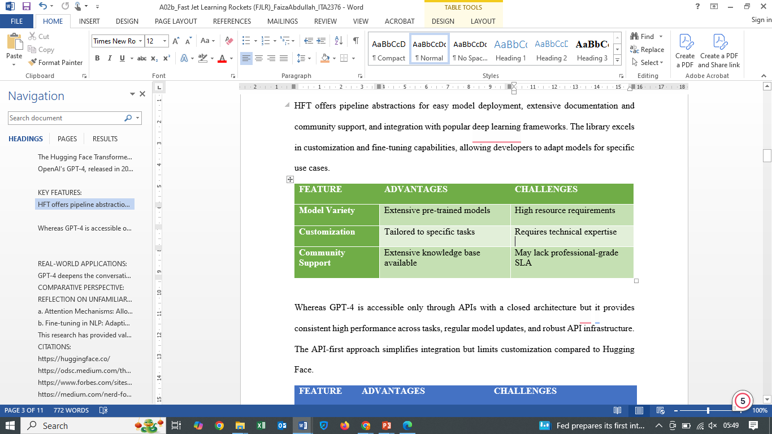
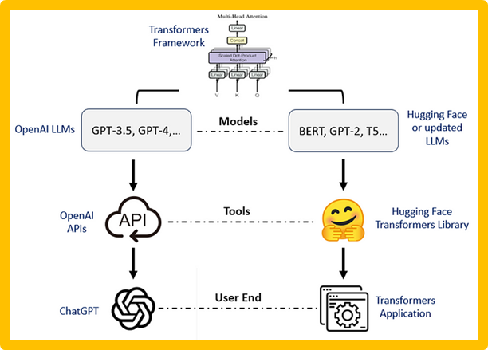
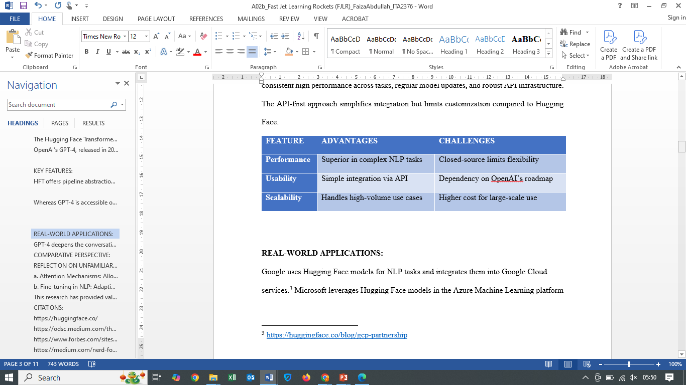
FEATURES MATRIX
HFT
OPENAI GPT 4

Slide 4


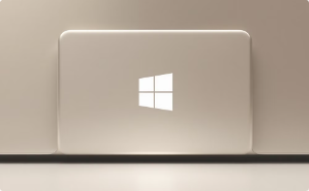

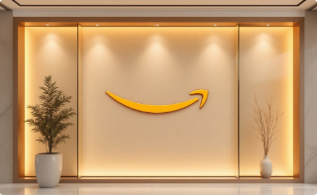
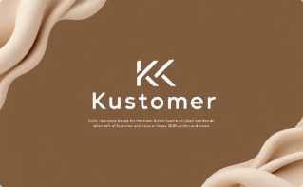
REAL-WORLD APPLICATIONS
Google
Microsoft
Meta
NLP tasks, Google Cloud services
Azure Machine Learning platform, pre-trained language models
AI and NLP research, transformer models for large-scale language applications
Amazon
Kustomer
Fine-tuning models in product recommendation systems, Amazon SageMaker
Omnichannel SaaS CRM platform, collaboration with AWS
Amazon
Fine-tuning models in product recommendation systems, Amazon SageMaker

Slide 5
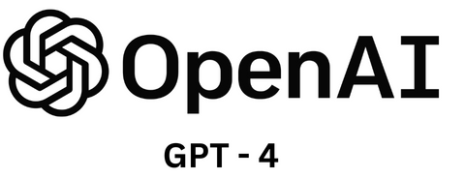



REAL-WORLD APPLICATIONS
Duolingo
Role Play and Explain my Answer features in Duolingo Max
Khan Academy
Powering Khanmigo, AI-powered virtual tutor and classroom assistant
GitHub
Upgraded Copilot Chat experience, enhancing accuracy and usefulness of code suggestions

Slide 6

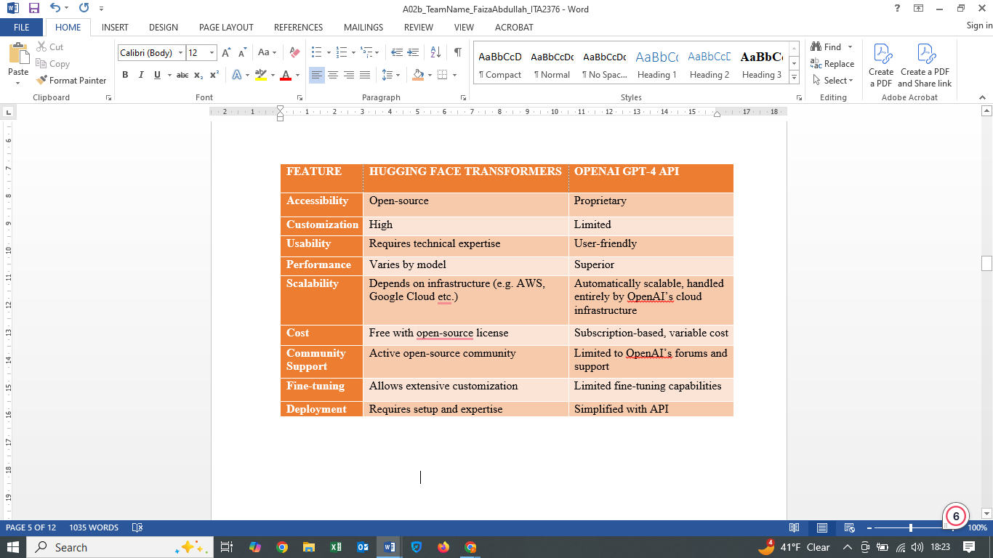
COMPARATIVE ASSESSMENT

Slide 7

HFT WORKFLOW
HF[Model Hub] → Local[Local Deployment]
The workflow begins with the Model Hub, a repository of pre-trained models provided by Hugging Face.
These models can be downloaded or cloned for local deployment, allowing developers to fine-tune or directly use them on their infrastructure.
Local → Custom[Custom Training]
After deploying the model locally, developers can perform custom training to adapt the model to specific tasks using their datasets.
Custom → Deploy[Production]
Once custom training is complete, the model is ready for production deployment, where it serves real-world applications or user requests.

Slide 8
GPT 4 API Workflow
API[API Endpoint] → Integration[System Integration]
This starts with the API Endpoint, which provides access to GPT-4 functionalities via the OpenAI API.
The API is integrated into the user's system for specific workflows or applications.
Integration → Production[Production]
Once the API is integrated, it is used in production environments to serve live applications, handle user interactions, or automate tasks.

Slide 9
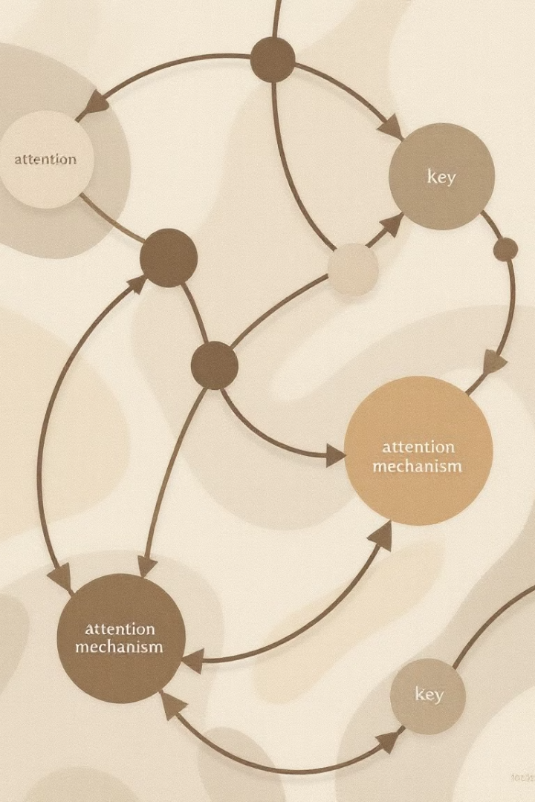
KEY INSIGHTS
Both workflows ultimately aim at production but differ in their approaches:
Hugging Face Transformers involve more customization and control (local deployment, training, and tuning).
GPT-4 API offers a plug-and-play solution, relying on a pre-existing endpoint with minimal setup.
The workflows can complement each other, for instance:
Use GPT-4 for initial prototyping via API.
Transition to Hugging Face for fine-tuning and self-hosted deployments if scalability, costs, or customization needs arise.

Slide 10
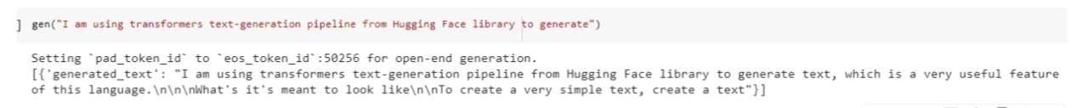
TEXT GENERATION WITH HFT
# install transformers !pip install transformers
from transformers import pipeline # create pieline for generating text gen = pipeline('text-generation') # uses GPT-2
gen("I am using transformers text-generation pipeline from Hugging Face library to generate")
https://medium.com/@lokaregns/text-generation-with-hugging-face-transformers-a-beginners-guide-6b0b4b957379

Slide 11
OPENAI GPT 4 API
import openai
openai.api_key = "sk-XXX"
response = openai.chat.completions.create(
model="gpt-4",
messages=
[{
"role": "user",
"content": "Generate a 3 sentence story about friendship"
}]
)
print(response.choices[0].message.content)
Lena and Sam had been best friends since childhood, always standing by each other through thick and thin. One stormy evening, Sam got stranded miles away, and without hesitation, Lena braved the rain to bring him home safely. That night, as they sat by the fireplace drying off, they realized that true friendship means always showing up, no matter what.
https://hasanaboulhasan.com/gpt-4-api-guide/

Slide 12

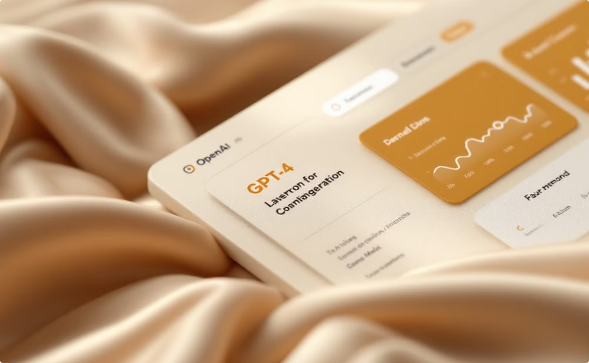
CONCLUSION
Hugging Face Transformers
OpenAI GPT-4 API
Offers superior flexibility and control, ideal for users with advanced technical skills
Provides exceptional out-of-the-box performance and easy integration, best for users prioritizing ease of use

Slide 13


